Slide 1
Handling Events in React
React Main Concept #6

Slide 2
Syntactic Differences Compared with Handling DOM Elements
DOM
React

Slide 3
Syntactic Differences Compared with Handling DOM Elements
DOM
React
Events are lowercase
Event handlers are passed as strings.

Slide 4
Syntactic Differences Compared with Handling DOM Elements
DOM
React
Events are lowercase
Event handlers are passed as strings.
Events are camelCase
Event handlers are passed as functions.

Slide 5
Syntactic Differences Compared with Handling DOM Elements
DOM
React
Events are lowercase
Event handlers are passed as strings.
Example:
<button onclick=“helloWorld()"> Hello World!</button>
Events are camelCase
Event handlers are passed as functions.
Example:
<button onClick={helloWorld}> Hello World! </button>

Slide 6
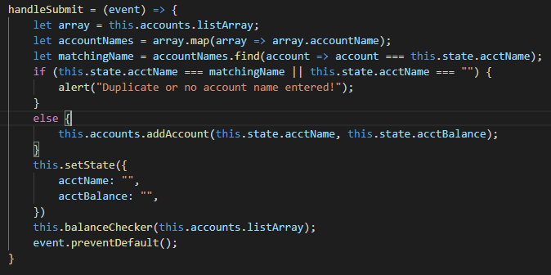
Prevent Default
All native HTML elements come with their internal native behaviour.
In React, you can’t return false to prevent a default behaviour. If there is a default behaviour that you are trying to prevent, you must call preventDefault() explicitly.
In the following example from when I migrated myAccounts exercise, preventDefault() was used to prevent the default behaviour of a form submit button, which would normally refresh the browser when it is clicked.
Notes:
If something is “implicit”, it means that the JS engine does it, if it’s “explicit”, it means the user must do it.

Slide 7

Prevent Default
TYLERED!
All native HTML elements come with their internal native behaviour.
In React, you can’t return false to prevent a default behaviour. If there is a default behaviour that you are trying to prevent, you must call preventDefault() explicitly.
In the following example from when I migrated myAccounts exercise, preventDefault() was used to prevent the default behaviour of a form submit button, which would normally refresh the browser when it is clicked.
Notes:
If something is “implicit”, it means that the JS engine does it, if it’s “explicit”, it means the user must do it.

Slide 8
Extra Prevent Default Info
The second most commonly listed use case for preventDefault() is to prevent the default behaviour when clicking on a link (going to the link’s URL)
In some situations, browsers will wait to see if preventDefault() is going to be called before proceeding with an event. One specific instance where this can cause issues is with the touchmove event that has to do with scrolling via a touch screen (primarily for mobile apps). Browsers can pause momentarily to check for preventDefault() before continuing to scroll. This can cause the scrolling to delay and “jitter”. In order to prevent the browser from waiting to check for preventDefault, you can specify “passive: true” in your event listener.

Slide 9
Binding “This”
In JavaScript, class methods are not bound by default. If ‘this’ is not bound, and you call a method (example: this.handleClick) and then pass it to an onClick event (example: <button onClick={this.handleClick}), ‘this’ will be undefined.

Slide 10
Passing Arguments to Event Handlers

